Slide 1
HOST Behaviour ANALYSIS FOR PROPERTY RENTAL COMPANY
OVERVIEW
In this project we learn about how host behaviour impact the company who deals with rental properties. We have serval countries to analysis but I chooses CANADA in which , I have combined the data of two states Vancouver and Toronto with the help of UNION JOIN to check the comprehend how the host behavior varies across a variety of metrics.

Slide 2
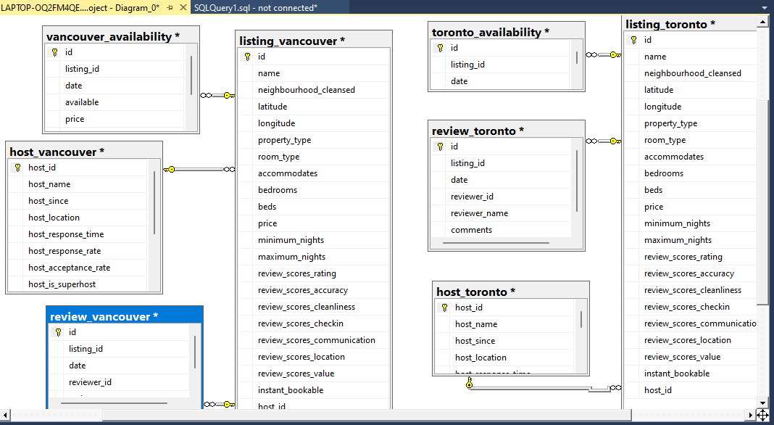
Modal Hypothesis

Slide 3
Ratings And Comments Relationship With Host AND Superhost

Slide 4
SUPER HOST AND HOST PROPERTY TYPE

Slide 5
Availability In Upcoming Year

Slide 6
HOST AND SUPER HOST BEHAVIOUR FOR COUNTRY VANCOVER AND TORONTO

Slide 7
Conclusion :
SUPER HOST have more good ratings and less number of bad ratings compared to HOST
The HOST has more large properties compared to the SUPER HOST.
Availability is less in HOST as compared to SUPER HOST. With the increase in months, increase in availability for SUPER HOST and a decrease in availability for HOST.
Average listing is the same for HOST and SUPER HOST which is 1 . Maximum number of listening done by HOST

Slide 8
THANK YOU

